Slide 1
Predictive Analysis

Slide 2
Machine Learning Algorithms
Machine Learning algorithm: a procedure in developing computer programs that improve their performance with “experience.”
Types of machine learning: Naïve Bayes, Linear Regression, Support Vector Machine, Decision Tree, Neural Network, Deep Learning, and so on.
Learning all algorithms are over the scope of this summer boot camp. We will focus on Logistic Regression and Decision Trees as examples of Machine Learning.

Slide 3
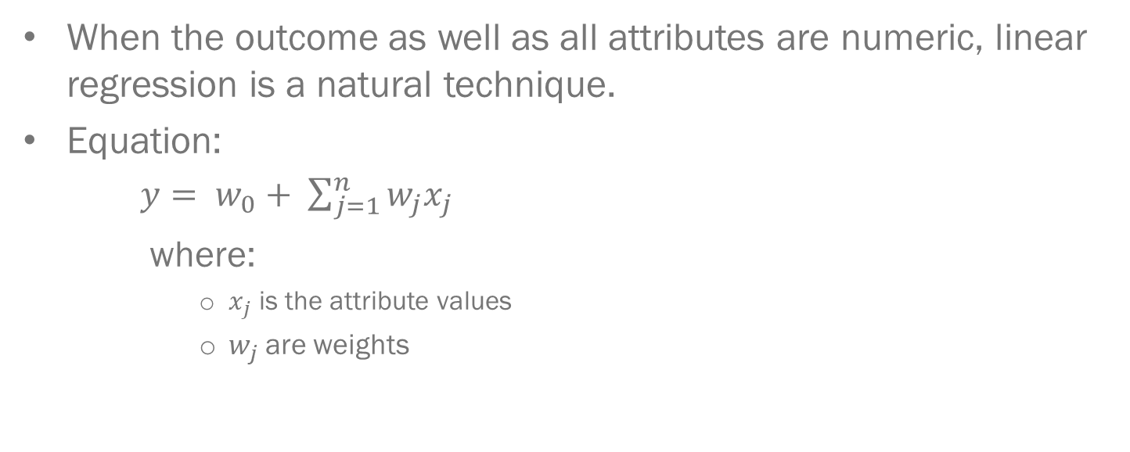
Linear Regression
When the outcome as well as all attributes are numeric, linear regression is a natural technique.
Equation:
$y= w_{0}+ \sum_{j=1}^{n}{w_{j}x_{j}}$
where:
$x_{j}$ is the attribute values
$w_{j}$ are weights
Notes:
Linear regression is a staple method in statistics.
The idea is to express the class as a linear combination of the attributes, with pre-determined weights.
Weights are calculated from the training data.

Slide 4
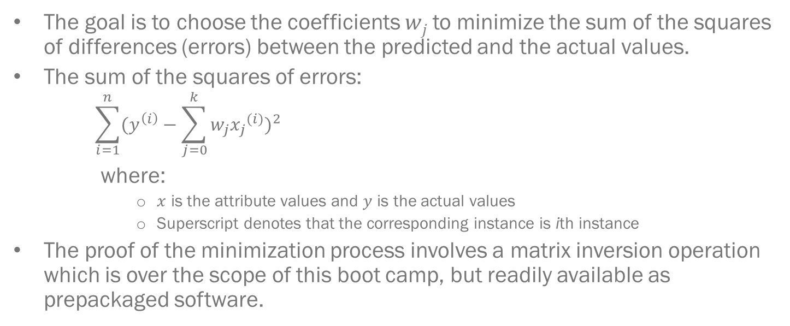
Linear Regression (cont …)
The goal is to choose the coefficients 𝑤_{𝑗} to minimize the sum of the squares of differences (errors) between the predicted and the actual values.
The sum of the squares of errors:
$$\sum_{i=1}^{n}{{(y^{\left(i\right)}−\sum_{j=0}^{k}{w_{j}{x_{j}}^{(i)}})}^{2}}$$
where:
$x$ is the attribute values and $y$ is the actual values
Superscript denotes that the corresponding instance is ith instance
The proof of the minimization process involves a matrix inversion operation which is over the scope of this boot camp, but readily available as prepackaged software.

Slide 5
Advantages vs. Disadvantages
Advantages:
Simple, excellent for numeric prediction.
Widely used in statistical applications for decades.
Disadvantages:
Assuming linear relationship between dependent and independent variables.
Assuming multivariate normality.
Assuming no or little multicollinearity.

Slide 6
Common Mistakes in Applying Linear Regression

Slide 7


Common Mistakes in Applying Linear Regression: Relationship Between Variables
Polynomial model: $y=a−b_{1}∗{{(x}_{1})}^{}$
$${{(x}_{1}−b_{2})}^{2}$$

Slide 8
Common Mistakes in Applying Linear Regression: Interaction of Attributes

Slide 9
Common Mistakes in Applying Linear Regression: Interaction of Attributes (cont …)

Slide 10
Common Mistakes in Applying Linear Regression: Interaction of Attributes (cont …)
 | High readability | Low readability
Large number of words | Useful | Not Useful
Small number of words | Not Useful | Not Useful
 | High readability (0.9) | Low readability (0.1)
Large number of words (0.9) | 0.81 | 0.09
Small number of words (0.1) | 0.09 | 0.01
* When cell values are multiplication of readability and number of words

Slide 11

Linear Classification: Perceptron Algorithm
parameters learned by the model
predicted value (e.g., 1 = positive, 0 = negative)
Notes:
Linear regression can easily be used for classification in domains with numeric attributes. Indeed, we can use any regression technique, whether linear or non-linear for classification. The trick is to perform a regression for each class, setting the output equal to one for training instances that belong to the class and zero for those that do not. The result is a linear expression for the class.
Imagine that there is a numeric membership function for each class. The membership function is 1 for instances that belong to that class and 0 for other instances.
Logistic regression does not suffer from problems. Instead of approximating the 0 and 1 values directly, thereby risking illegitimate probability values when the target is overshot, logistic regression builds a linear model based on a transformed target variable.

Slide 12
Linear Classification: Perceptron Algorithm (cont …)
test instance
model weights
f_1 | f_2 | f_3
0.5 | 1 | 0.2
w_0 | w_1 | w_2 | w_3
2 | -5 | 2 | 1
output = 2.0 + (0.50 x -5.0) + (1.0 x 2.0) + (0.2 x 1.0)
output = 1.7
output prediction = positive

Slide 13
Linear Classification: Perceptron Algorithm (cont …)
What problems can you anticipate with perceptron algorithm?
The value ranges from - ∞ to + ∞ which is not ideal for probability.
Hard to set the threshold for different classes.

Slide 14
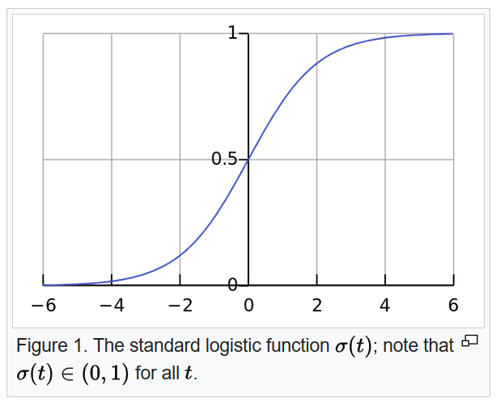
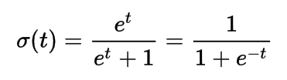

Linear Classifier: Logistic Regression
$${t=w}_{0}+ \sum_{j=1}^{n}{w_{j}x_{j}}$$
when
(source: https://en.wikipedia.org/wiki/Logistic_regression#/media/File:Logistic-curve.svg)

Slide 15
Decision Tres
Conceptual Overview
Give Medical Example

Slide 16
Regression Vs. Classifcation Trees

Slide 17
Advantages vs. Disadvantages

Slide 18
Common Mistakes
Overfitting
Talk about pruning

